Slide 1
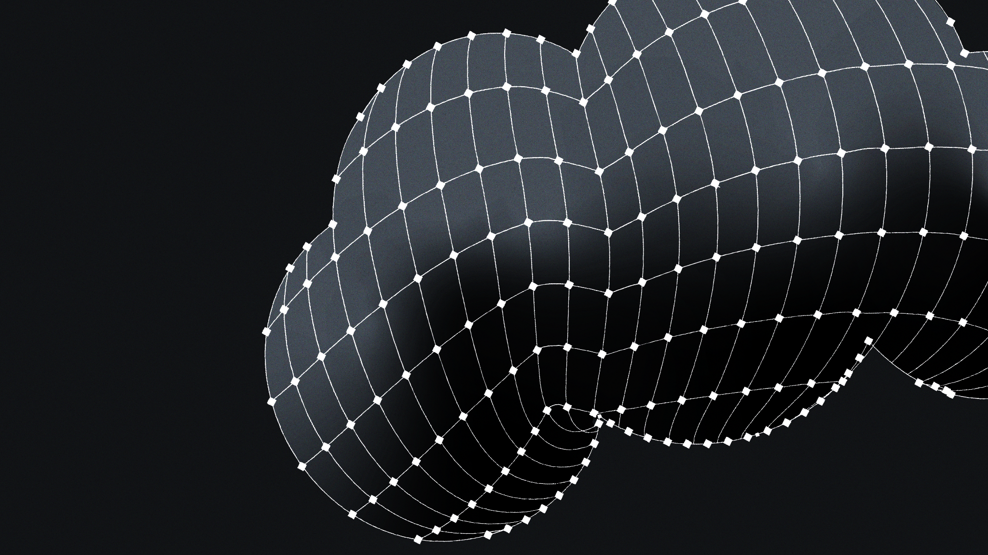
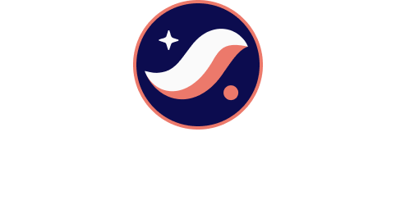
Moosh
Starknet -
Re{ignite} Hackathon Submission
26 May 2025
Recipient: Starknet Re{ignite}

Slide 2
About Us
We are a Team Building Web3 Cloud

Slide 3
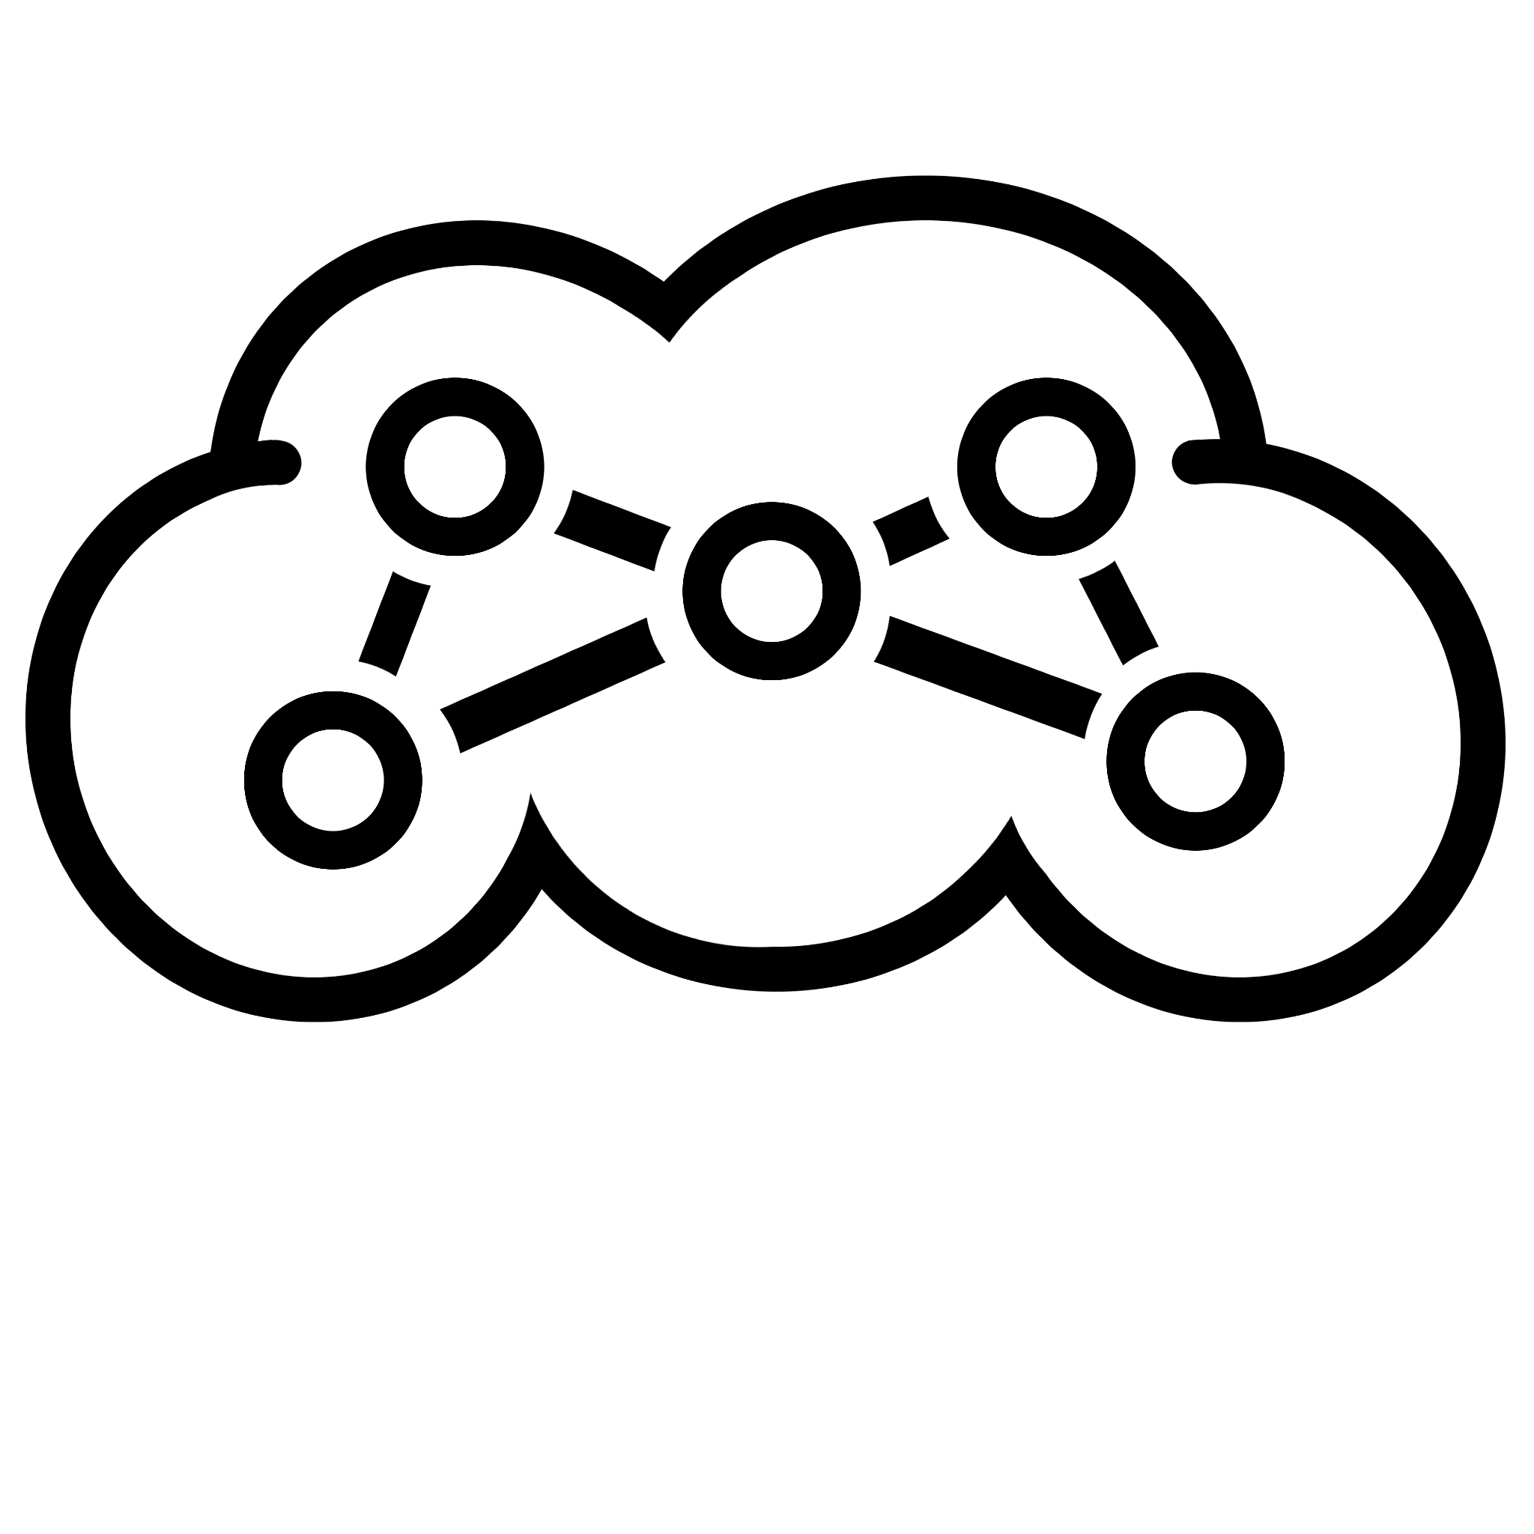
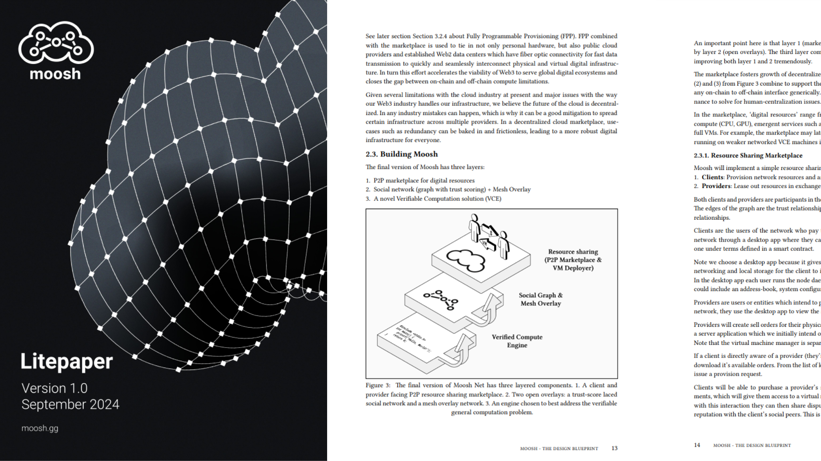

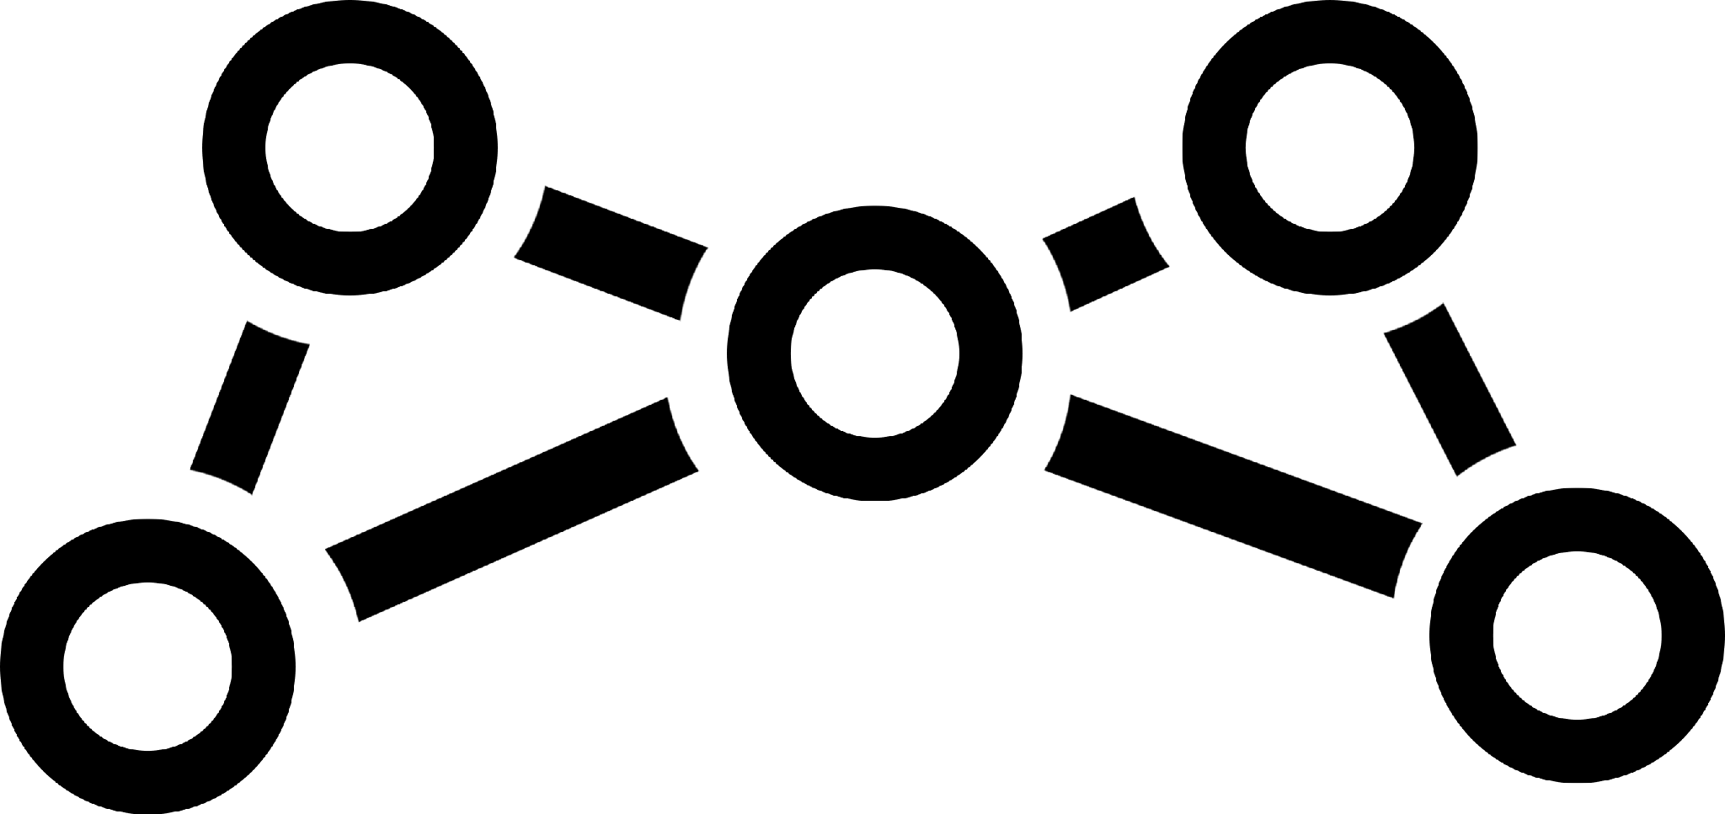
What’s the Big Idea?
‘Decentralized
+
Cloud Marketplace’
=
moosh.gg
Litepaper <www.moosh.gg>

Slide 4
What’s the Big Idea?
Decentralized Cloud Marketplace
Moosh is a decentralized peer-to-peer (P2P) social network for joining trustless & trust-dependent systems and sharing digital resources.
moosh.gg
Litepaper <www.moosh.gg>
Notes:
Blockchains a reisolated islands of immutable data
Infrastructure involves real world objects outside of blockchain’s domain
Need to join the two together and minimize trust

Slide 5
Notes:
Blockchains a reisolated islands of immutable data
Infrastructure involves real world objects outside of blockchain’s domain
Need to join the two together and minimize trust

Slide 6

Our Submission
MooshID: Efficient Post-Quantum On-Chain Identity System

Slide 7
Overview of Submission - (1/2)
We are entering for the ‘Best use of Starknet’ track of the 2025 Re{ignite} hackathon.
We’ve made a breakthrough, introducing a new primitive in quantum resistant signature verification using the Falcon cryptography scheme.
Future downstream contracts that build on our submission by anyone don’t need to worry about storage, they just use a small 252 bit hash.
Call data is 28x smaller for small Falcon 512 key size, and 56x smaller for big Falcon 1024 key size.
Our effort aligns with Bitcoin also wanting to use PQC Falcon in BIP360 …
Quantum proof signatures and public keys are orders of magnitude larger than predecessors, directly increasing the amount of data stored per transaction on a blockchain and bloating Smart Contract (SC) storage. We have made a significant reduction in size of a Quantum Resistant pubkey [ We reduce it from 897 or 1793 bytes down to 252 bits ]. We store it once on chain (this costs gas but this addresses spam protection), then once stored you can verify gas-free in the future (computation is done on RPC node instead of via gas payments). This reduces state bloat, increases block throughput and lowers SC storage gas cost!
We have applied the solution to the use case of an on-chain marketplace, where a client pays a provider for services/resources.

Slide 8
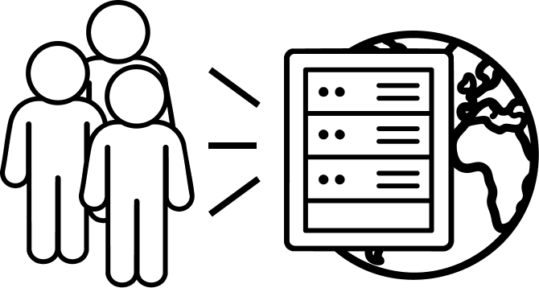

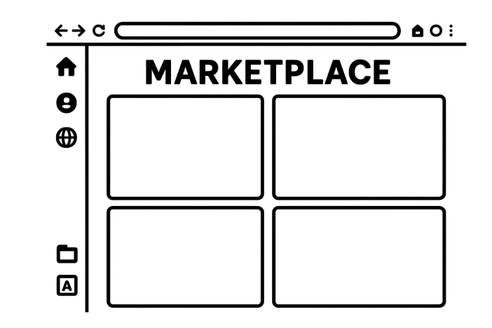
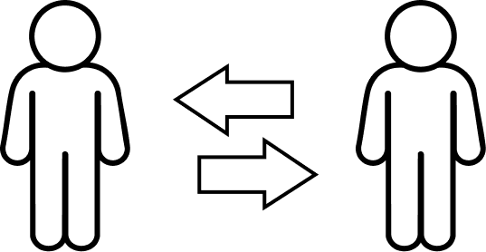
Overview: 3 Steps to use the Solution - (2/2)
Contract 1:
Key Registry
Contract 2: Address-Based Verifier
Contract 3: Marketplace Escrow Contract
First actor deploys key registry contract that lets other people store their key material in a storage map. Maps keys to key-material on chain.
Read contract: Lets anyone verify a signature using the hash of anyone’s pubkeys that originally signed it.
Use case - Escrow contract for two actors. A client pays for services from an ID’d provider. A dispute mechanism is built in for intermediaries to resolve conflicts on chain.

Slide 9
Contract 1: Key Registry (1/1)
To bootstrap the system, an initial person deploys this smart contract named ‘key registry.’ This contract lets other people store their key material in a storage map. It maps key-hash to key-material on chain. In our use-case providers of services are these people.
We use Falcon for Post Quantum Crypto signatures
Poseidon felt252 for hashing Falcon pubkeys
The read functions are:
get_key_owner() - Takes a hash and returns the wallet that registered it to the contract
get_public_key() - Get’s a pubkey from submitted hash.
The key-registry owner is what is important for scaling past the storage capacity of a single Key Registry smart contract.
*’Key-material’ in our case is a Falcon public key

Slide 10

Contract 2: Address-Based Verifier (1/2)
This is a read contract that lets anyone verify a signature using the hash of the pubkey that originally signed it.
This is experimental as we use a new Starkware exploration team library called S2morrow (1 month old)
We borrow their verify-uncompressed function
One public key signs any kind of message, with no length limit on input, the output is a felt 252 size.

Slide 11
Contract 2: Address-Based Verifier (2/2)
Take three inputs: key_hash, signature, message
It queries the Key Registry to get the Falcon public key from the key_hash
Then it verifies the signature for the message for that public key
Contract returns True or False i.e. determines Valid or Invalid signature
In our demo use case the marketplace provider has to sign a predetermined message that is the listingID of their services listed on the marketplace.

Slide 12
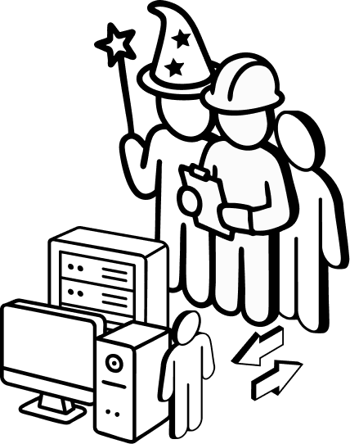
Contract 3: Marketplace Escrow (1/2)
This marketplace contract is dependent on both the Key Registry SC, and the Address-based Verify SC.
It uses the Key Registry to resolve the pubkey from a pubkey hash for free (no gas).
The good thing is that any Starknet app can use this, the Key Registry and Verify SC’s are generic. Only the Escrow SC is use-specific.
Ideally we would have a single marketplace-deployed escrow SC to handle multiple agreements instead of currently making the client deploy the Escrow SC for one agreement. However, the provider can verify the Starknet class hash of the escrow SC to check the client didn’t deploy a malicious SC.
Note: Only the provider needs to be ID’d on MooshID!

Slide 13
Contract 3: Marketplace Escrow (2/2)
Step 1: A provider creates listing of their services in a Web3 marketplace app (this is outside of the scope for this hackathon). The listing would have an associated on-chain listingID attested by a blockchain node network.
Step 2: A Client (1) deploys escrow contract, (2) supplies the key-hash of the provider they want to make an agreement with, and (3) deposits funds into the contract
Step 3: If everything goes well, at the end of the agreement-period the provider can execute a claim function in the escrow contract and extract the funds. Note, the claim function only works if the agreement-period is over.
A provider has a Falcon pubkey and privkey. The pubkey is hashed in the Key Registry contract, the privkey only they know.
To claim the funds the provider signs the listingID with their falcon private key on their local machine and gives it to the escrow contract. In turn the escrow contract interacts with the Address-verifier to check if the signature is valid or not.
If signature is valid, funds are released, if-not then no funds are released.
Optional: Step 3.5: If there’s a dispute over the services provided before the agreement’s tenure is completed (e.g. services are not up to the desired standards), the provider gets partial payment up to the time served, the remainder is returned to the client. Note only the client is able to initiate the dispute.

Slide 14
USER INTERFACE
Demo built in
To showcase

Slide 15
LINKS & RESOURCES
Github: https://github.com/moosh-network/starknet-reignite
Video:
Smart Contract Classes deployed on mainnet:
Key Registry:
Address-based-verifier:
Escrow:

Slide 16
Project Extensions
What to do next?

Slide 17
From client side we can call the contract recursively to do message chain verification. To handle complex messaging for advanced escrow disputes requiring a history of agreement terms or other information
We would want to allow agreements to be extendable. Modification of terms.
The initial single Key-registry contract will deploy new Key Registry whenever needed, i.e. if one SC is full (max is 100 keys today: 100 keys in 3000 Starknet SC storage slots) the Key Registry Factory can spawn further contracts once the first is full.
In today’s example it is important to trust who deploys the escrow contract class. Need to remove this trust.
Root of trust improvements. In future the Key Registry contract owner can be extended be a single router wallet that will deploy all the keys based on how much capacity is needed. I.e. as one SC runs out of space, another is created. The Router maps hash to the registry and so on. This is similar to how how uniswap charges for creating new liquidity pools.
Factory & Router Cairo contracts for Key Registry to scale over 100 falcon keys per SC
Extend solution to use a Falcon certificate instead of just a normal key, so that a cert can also have a shortened address on Starknet.
Further extend to open an on-chain Falcon certificate in a CLI or browser UI for an Web3 app.
Extend logic to verify two parties consent to a single agreement.
Would go over 3 milllion steps if we have to verify two addresses using current methodology - requires optimization.
Explore extending this idea for a Peer-to-Peer marketplace for Virtual Machines.

